Slide 1


CANARA ENGINEERING COLLEGE
Benjanapadavu, Mangalore– 574219, D.K. Karnataka.
DEPARTMENT OF COMPUTER SCIENCE AND ENGINEERING
Internship Presentation
S SREENIVASA SHENOY
4CB19CS087
Guided by
Prof. Shatananda Bhat P

Slide 2

1. Company
Name | QSpiders Campus Connect
Address | No. 369/b,41st Cross Road old Police station stop, 4th Block, Rajajinagar, Bengaluru, Karnataka, 560010
Contact Number | +91-9845687781
Email | onlineenq@qspiders.com
Website | http://www.qspiders.com
Company Registration Number | U72200KA2007PTC044701
Type of the Company | Private
Nature of the Company | Information Technology
Vision | “Aim to bridge the gap between the demand of the industry and the curriculum of educational institutions.”
Company Operational Status | Multi-National

Slide 3
2. About the Company
QSpiders is the world’s ace software testing training organization founded in 2003 by Girish, a seasoned executive leader, founder & CEO of Test Yantra Software Solutions, QSpiders, JSpiders, and Flagroot.
The mantra of QSpiders is “Quality” and this is reflected in the way they train, in the way they function, and more so in their name “QSpiders”.
QSpiders is where talent meets opportunity and they believe a trainee who comes over here in search of his dream job or the dream professional ends here.
Qspiders in order to provide the job opportunity and make a student into a professional IT candidate has extended its branches into 19 parts of the world.

Slide 4
Qspiders have experience in providing on-site and offshore corporate training programs and have successfully delivered many corporate training programs so far.
Qspiders work with many organizations to provide corporate training in courses including Software Testing & Development.
After the training, if the engineers start implementing the topics learned during training, they provide free guidance to identify the gaps and fine-tune the understanding for half a day (if required). The trainers have more than 6 years of experience in the area of Software Testing & Development.

Slide 5
3. Task Performed
3.1 Java
Java is a popular programming language that was developed by James Gosling at Sun Microsystems in the mid-1990s.
It is an object-oriented language that is known for its platform independence, which allows developers to write code once and run it on multiple platforms.
Java is widely used for building web applications, mobile applications, desktop applications, and enterprise applications.
The Java assignments encompassed a comprehensive range of topics, including both fundamental and challenging concepts

Slide 6
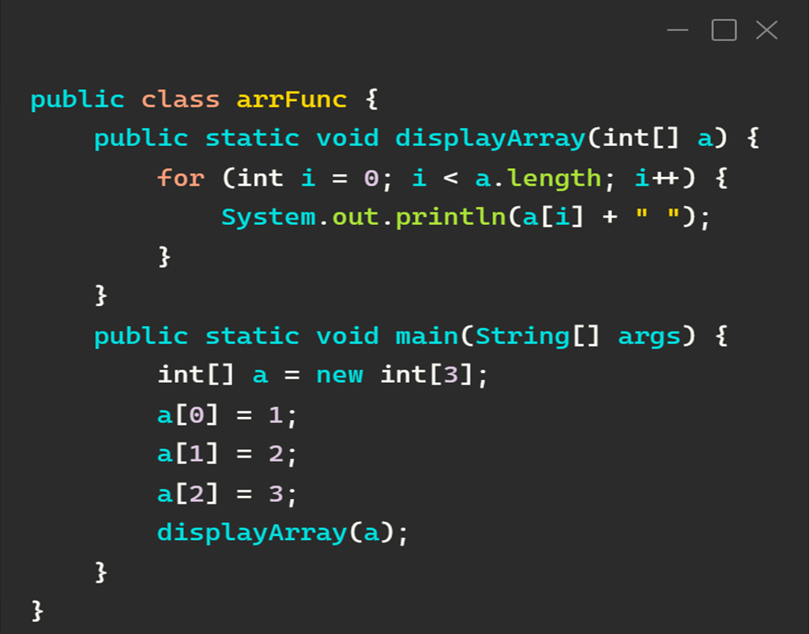
Task #1
Write a function to print an array.

Slide 7
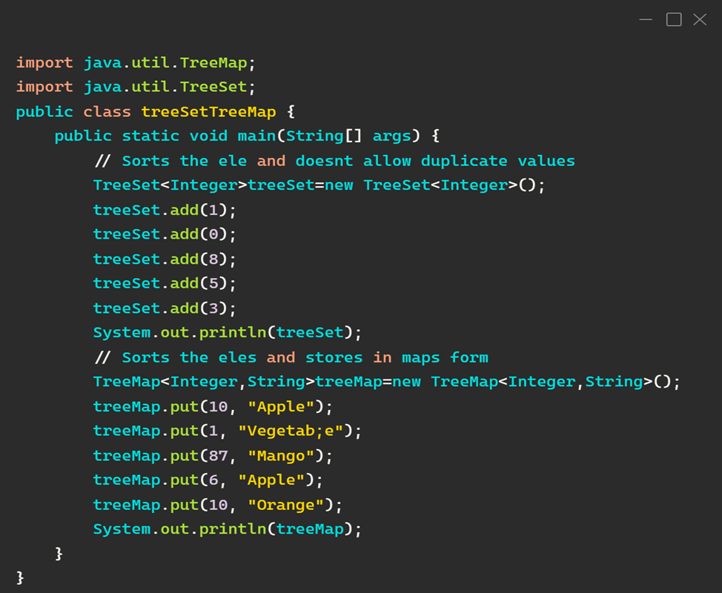
Task #2
Write a program to demonstrate TreeSet and TreeMap.

Slide 8
3.2 Web Development
Web development is the process of creating websites and web applications for the internet or an intranet.
It involves several disciplines, such as web design, web programming, server-side scripting, and network security. The internship tasks were based on HTML, CSS, and JavaScript which are the fundamental technologies for Web development.
HTML (Hypertext Markup Language) is a markup language used to create the structure and content of web pages.
CSS (Cascading Style Sheets) is a style sheet language used to describe the presentation and visual appearance of HTML documents.
JavaScript (JS) is a high-level programming language that is commonly used to create interactive web pages and dynamic web applications. JS allows developers to add interactivity, animations, and advanced functionality to web pages.

Slide 9
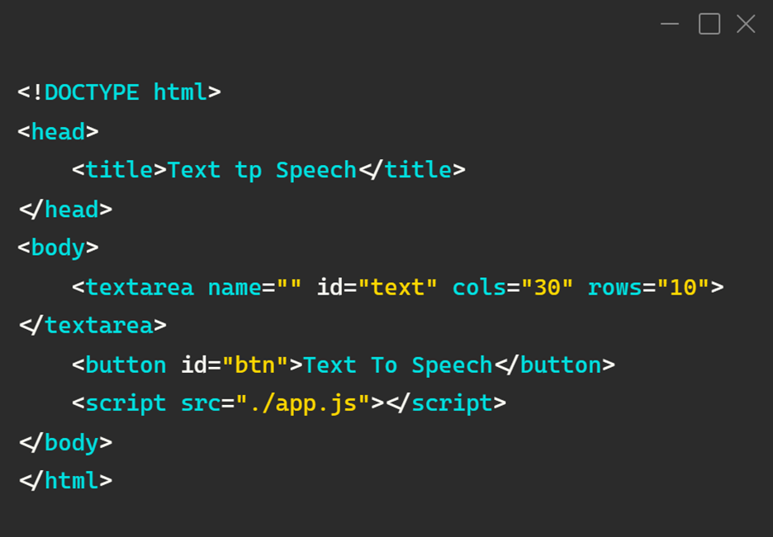
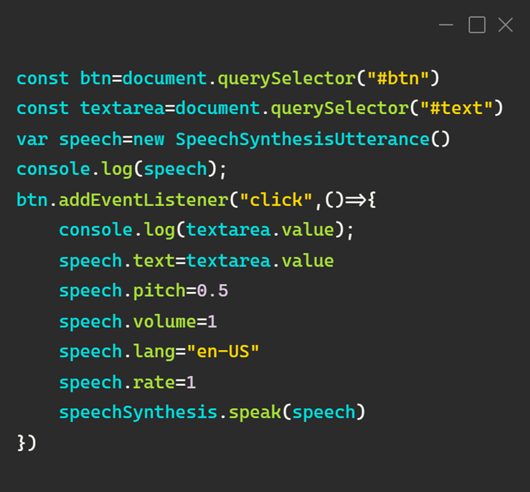
Task #1
Text to Speech application.

Slide 10
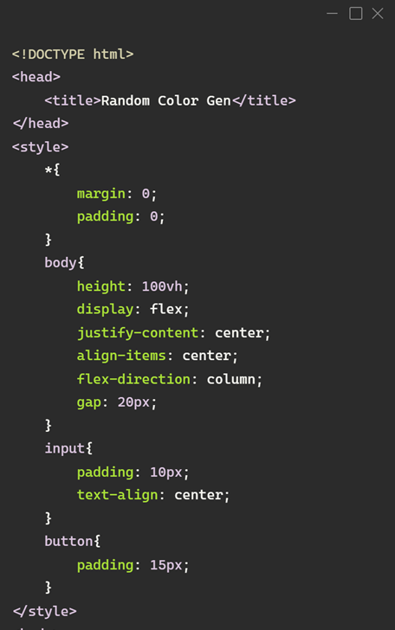
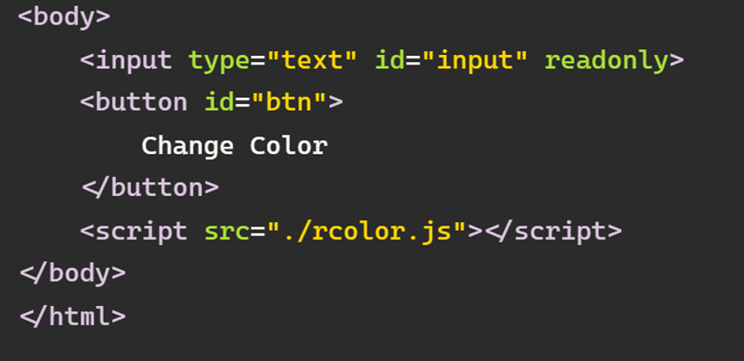
Task #2
Random colour generator web application.

Slide 11
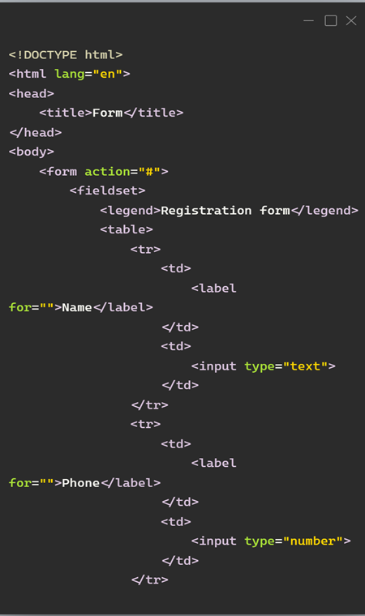
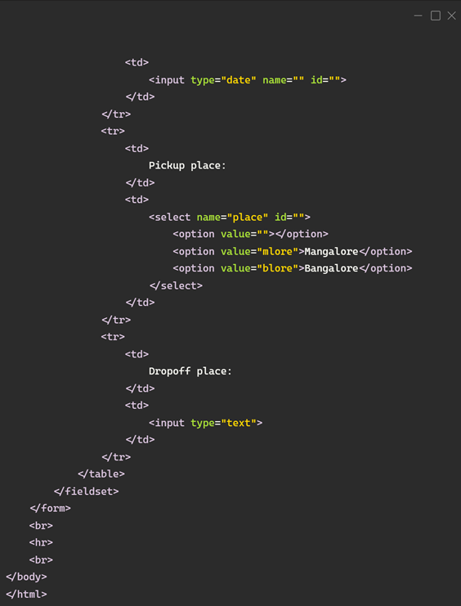
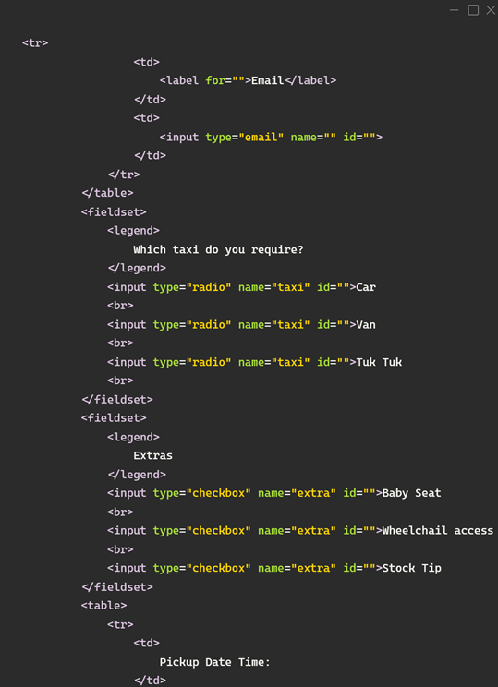
Task #3
HTML Form using various input methods.

Slide 12
3.3 Project Work
Kool Screen is a Flutter wallpaper app that provides users with an extensive collection of high-quality wallpapers from Pexels.
The app features a wide range of wallpaper categories, including nature, abstract, sports, and movies, and users can search for wallpapers based on keywords, colors, and orientation.
One of the key features of Kool Screen is its integration with the Pexels API. The API provides the app with a vast collection of high-quality wallpapers, ensuring that users always have access to fresh and exciting content.
The app's user interface is designed to be simple and easy to navigate, allowing users to quickly find the wallpapers they want.
Overall, Kool Screen is an excellent option for users looking to personalize their devices with high-quality wallpapers. Its seamless user experience, extensive collection of wallpapers make it an ideal choice for anyone looking to spice up their device's wallpaper collection.

Slide 13
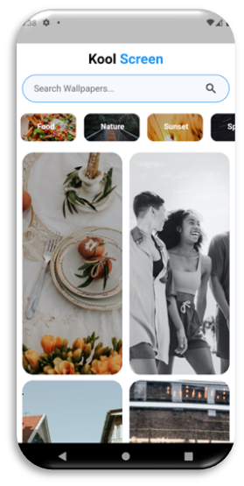
Figure 3.3.1
Home Section
The home section of the app contains vast collection of high-quality wallpapers, ensuring that users always have access to fresh and exciting content.

Slide 14

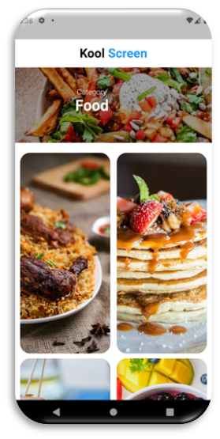

Figure 3.3.2
Category Section
The app's category features make it easy for users to discover new trending category wallpapers and keep their wallpaper collection fresh.

Slide 15
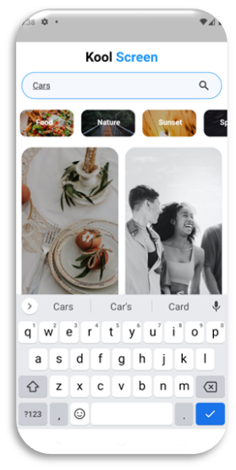
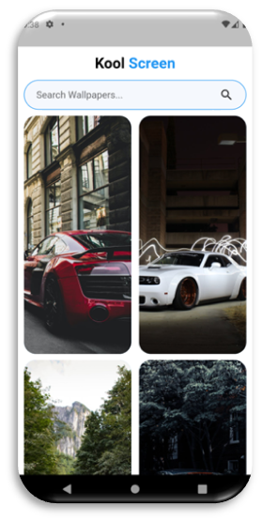
Figure 3.3.3
Search Section
The app’s search feature makes it easy for users to search wallpapers based on their own visual taste and various criteria, including colours and orientation etc.

Slide 16
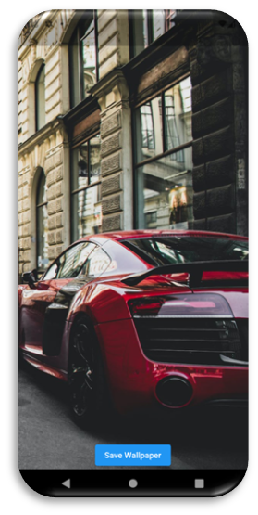
Figure 3.3.4
Save Wallpaper Section
The app provides “Save Wallpaper” option which helps users to save their most liked wallpaper into their device gallery and then customize accordingly and set their mobile wallpaper, ensuring a perfect fit every time.

Slide 17
4. Reflection
My internship at Qspiders Campus Connect was a valuable experience that not only improved my technical skills but also helped me develop essential interpersonal skills.
During the internship, I assisted with the testing and debugging of software applications and collaborated with team members on various technical projects. I was also given the opportunity to work on real-world projects, such as developing a mobile application.
While the technical tasks were challenging, I also faced personal challenges, such as adjusting to a new work environment and managing my workload. However, I learned to overcome these challenges by prioritizing my tasks and seeking help when necessary.

Slide 18
In addition to technical skills, the internship also helped me improve my communication and teamwork skills. I also learned the importance of being consistent and delivering high-quality work, which has helped me in my personal and professional life.
Moving forward, my internship experience has solidified my passion for software development, and I plan to pursue a career in this field. I am confident that the skills I gained during my internship, such as problem-solving, collaboration, and effective communication, will help me achieve my future goals.

Slide 19
5. Conclusion
The internship provided an excellent opportunity to learn new skills and knowledge.
I now have grown in my comprehension of the professional standards currently promoted by the industry, have learned about the various facts of working in a respectable field, and have improved my understanding of project development, database connectivity, and other study-related topics.
This internship programme was an opportunity for knowledge, ideas, and opinions to be shared.
Additionally, I have learned more about the field of Full-Stack web development as a whole. I am sure that the skills I've developed during this internship will be useful to me in my future endeavours.
My desire to work in core industries has increased as a result of this internship.

Slide 20
THANK YOU

